Slide 1
Moments
[insert funny™ here]

Slide 2
Moment of Inertia

Slide 3
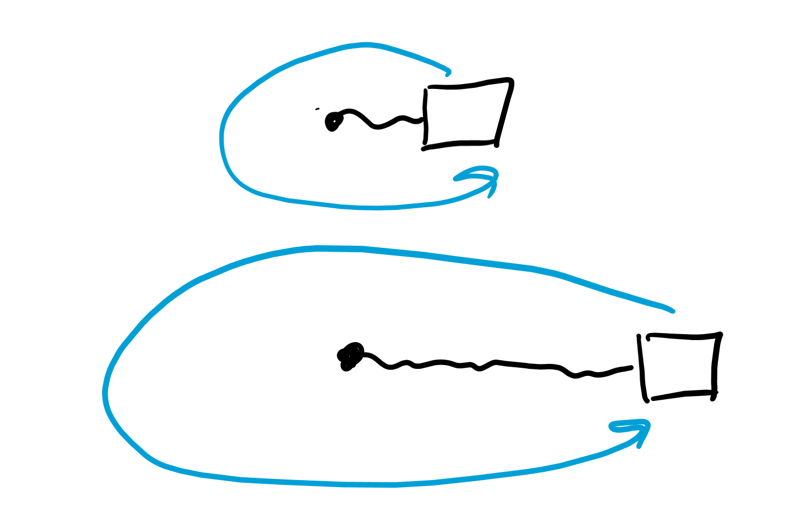
Spinning objects
Which is harder to spin:
A meter long rope with a weight tied to it
OR
A 2 meter long rope with the same weight tied to the end

Slide 4
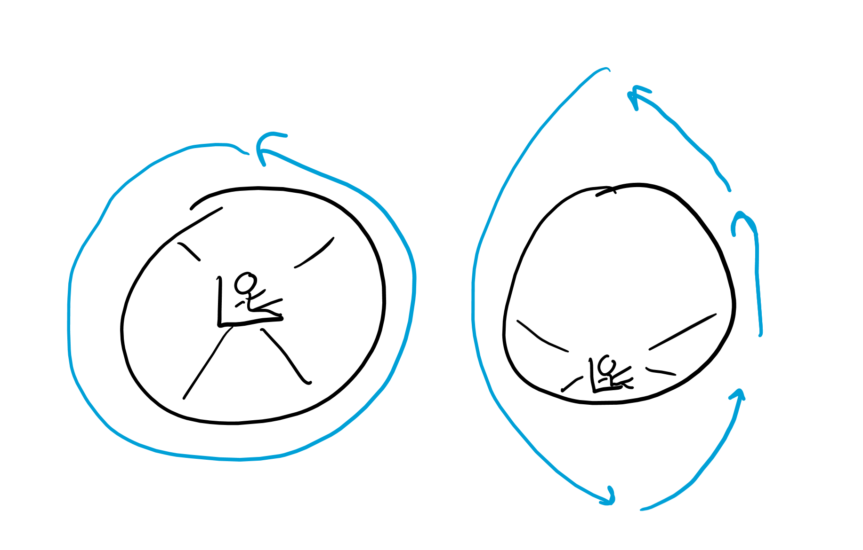
“Spinny” mass
Mass tells us how hard something is to push (more mass, harder to push)
When we look at rotating objects, mass isn’t enough to tell us how hard something is to spin
After all, if the mass is further, it’s harder to spin
So we have I, which stands for “moment of inertia” which represents how hard it is to spin an object
Anytime we see “moment” that means spinning is involved

Slide 5
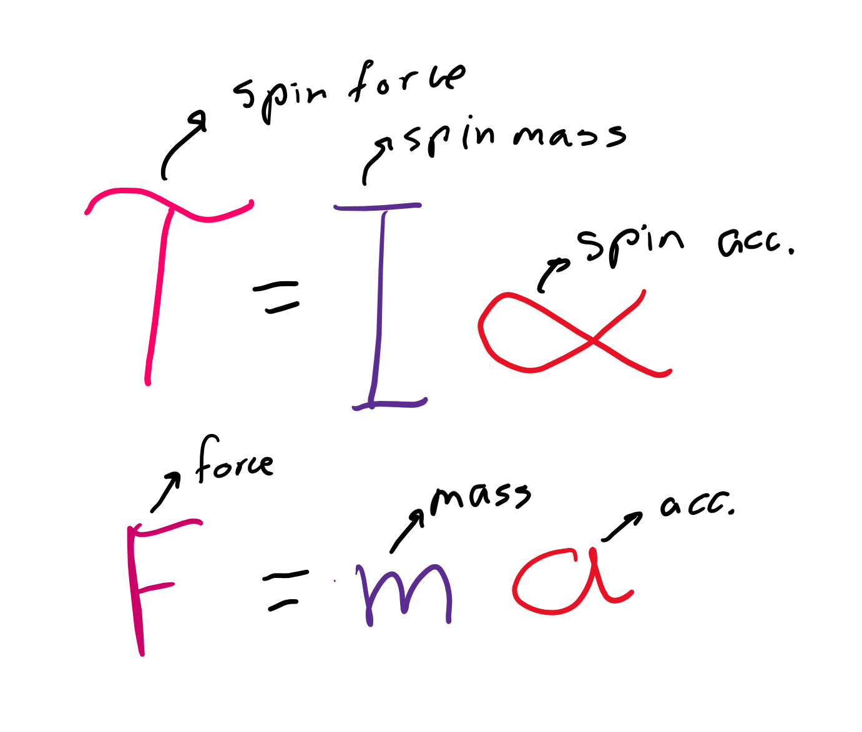
Torque
We said torque is the “spin” force
We know F = ma
So torque (τ or Τ) should equal “spin” mass times “spin” acceleration
Spin mass: I = mr^2
Spin acceleration: ɑ = a/r
Τ = Iɑ = mr^2 * a/r = r * ma = r x F

Slide 6
Electricity

Slide 7
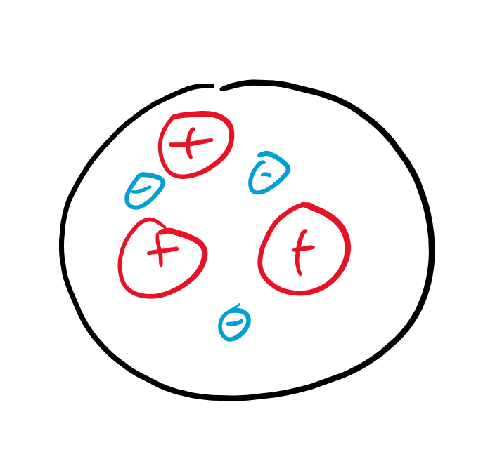
Does electricity have to be a dipole?
Can we have a positive charge without a negative one?
What particles carry a single charge?

Slide 8
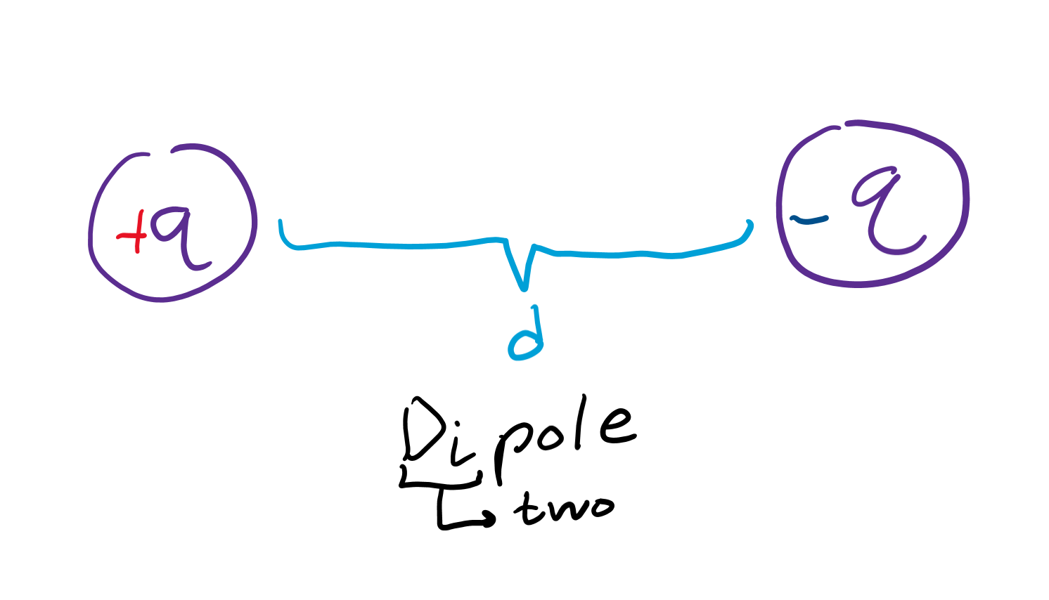
Electric moment
Calculated as q * d, represented as p
q is the charge and d is the distance between charges
Electric acceleration we said was E
Τ = p x E

Slide 9
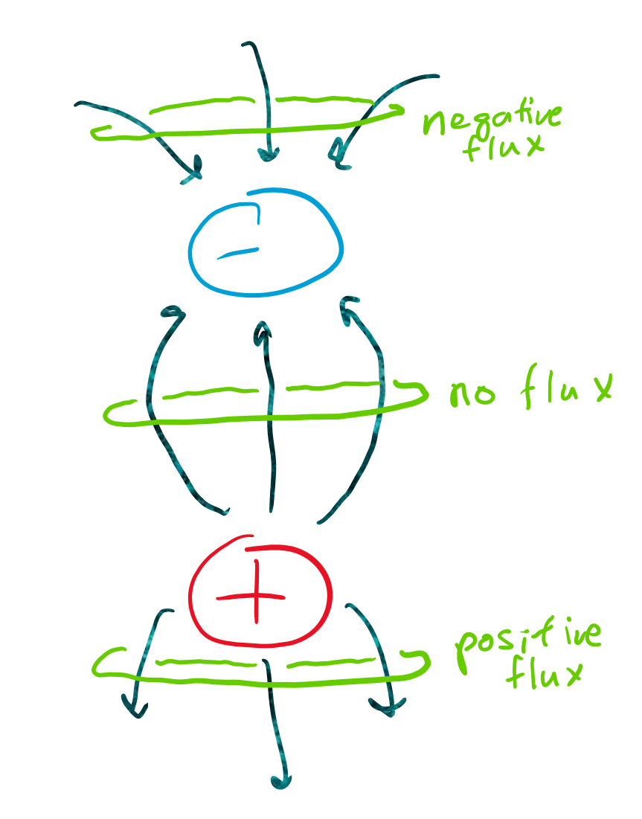
Flux
Flux is how much stuff is “coming out” or “going in” a some enclosed surface
Water leaking out of a bottle is flux because we have water going out of a water bottle
Positive charges emit electric flux
Negative charges suck in flux

Slide 10
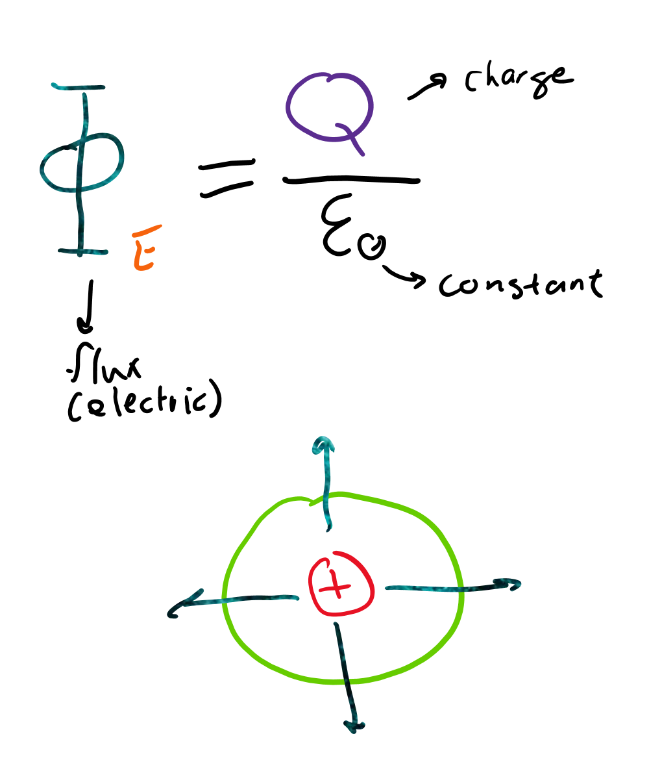
Gauss’s law electricity
Let’s say we have a bottle with one proton
AND
A bottle with two protons
Which has more ‘flux’?
Flux is proportional to amount of charge enclosed in the surface

Slide 11
Magnetism

Slide 12
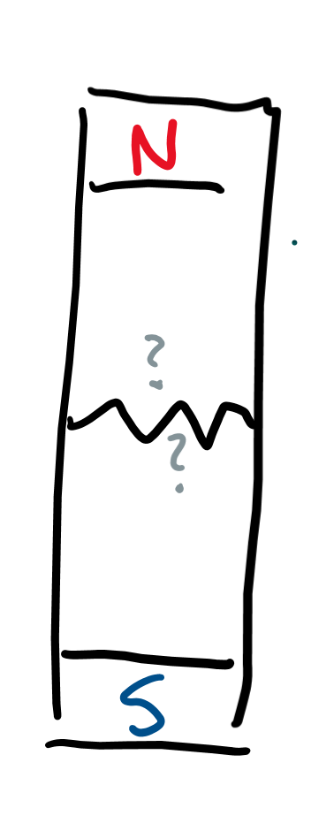
Do magnets have to be dipoles?
Can you cut a magnet so you only have a north end and not a south end?

Slide 13
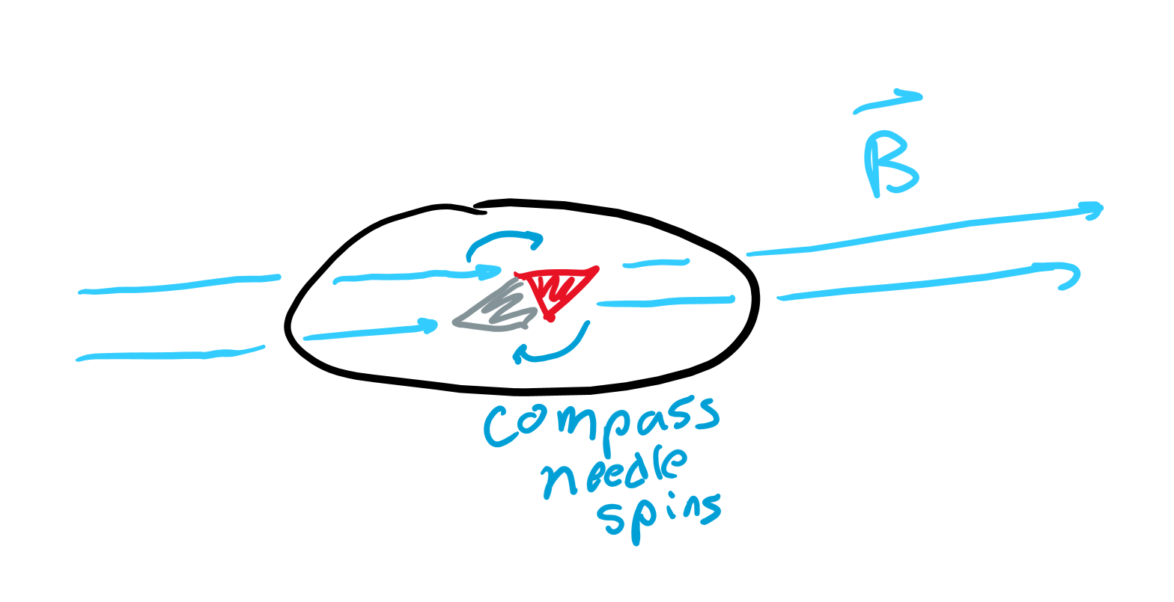
Magnetic moment
We can’t exactly measure the distance between “magnetic charges” because there isn’t one proton or one electron to contribute charge
Let’s just call the dipole moment m
Magnetic acceleration we said was B
Τ = m x B

Slide 14
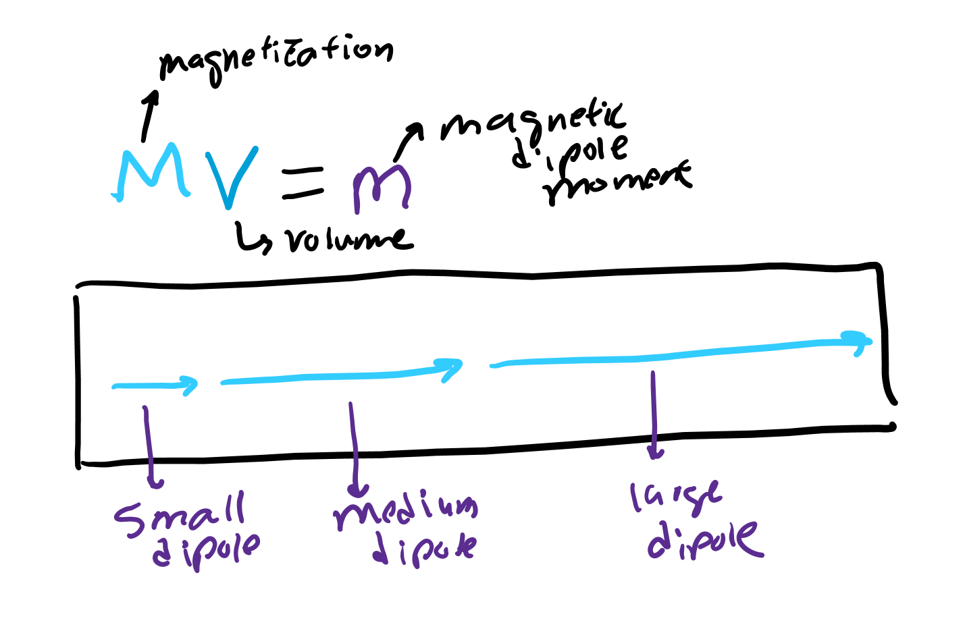
How to find m?
We can measure M, the magnetization of an object
If the object is “magnetized” over a larger volume, we have more dipole moment
M * V = m

Slide 15
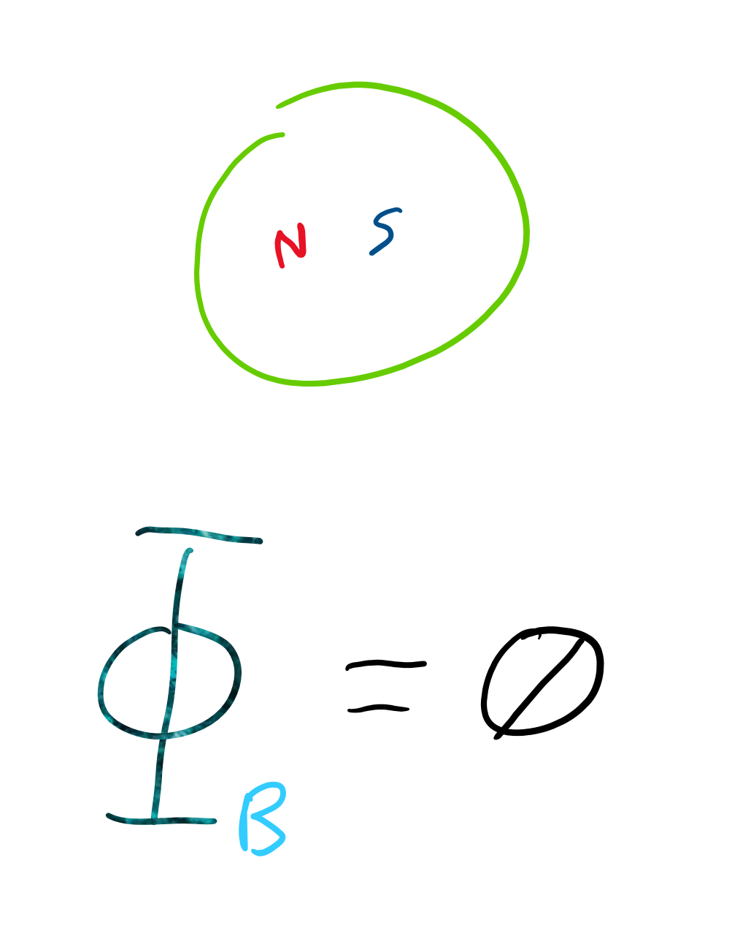
Gauss’s law magnetism
For every north we enclose, we also have to enclose a south
Net amount enclosed is 0
Thus, flux is always 0
If magnetic monopoles existed, then flux would not always be 0

